Slide 1
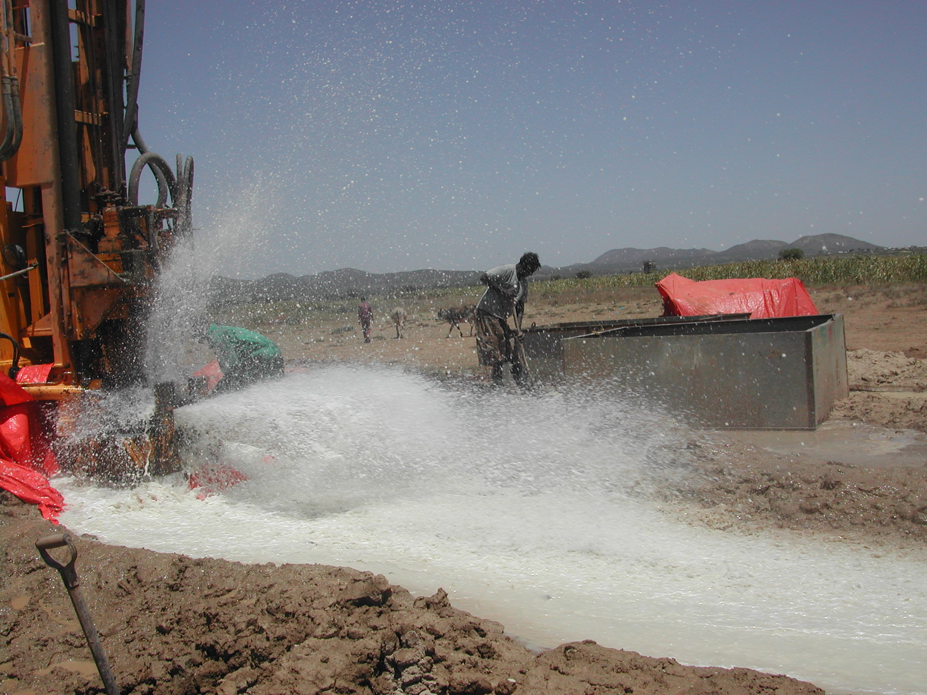



DEPLETION OF BORAMA AQUIFER
PREPARED FOR:
Republic of Somaliland
Ministry of Water Resources Development
Borama Groundwater Sustainability Studies, Somaliland
SDF Ref No: P101-174
BY BRUNO PETRUCCI

Slide 2
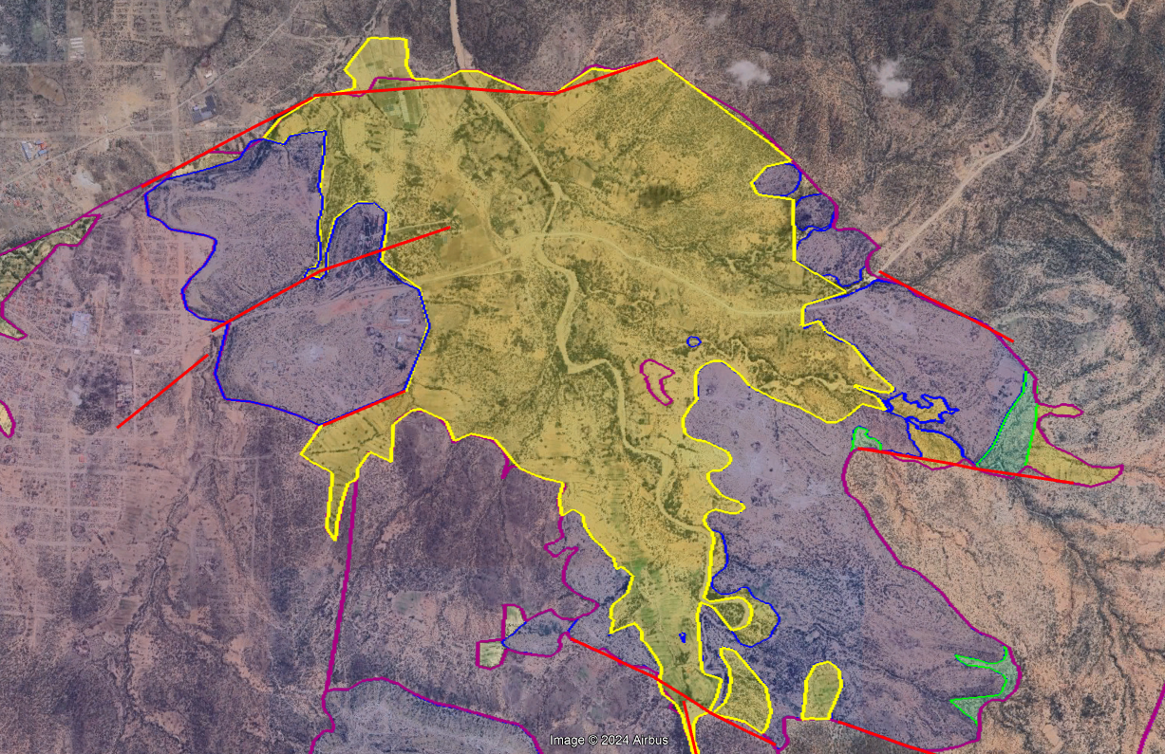
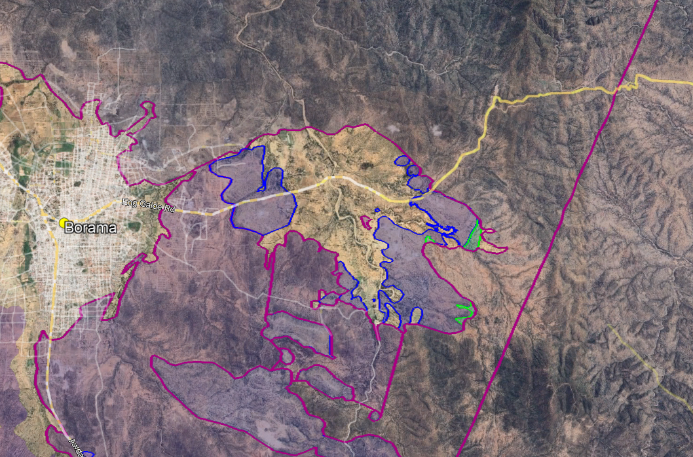
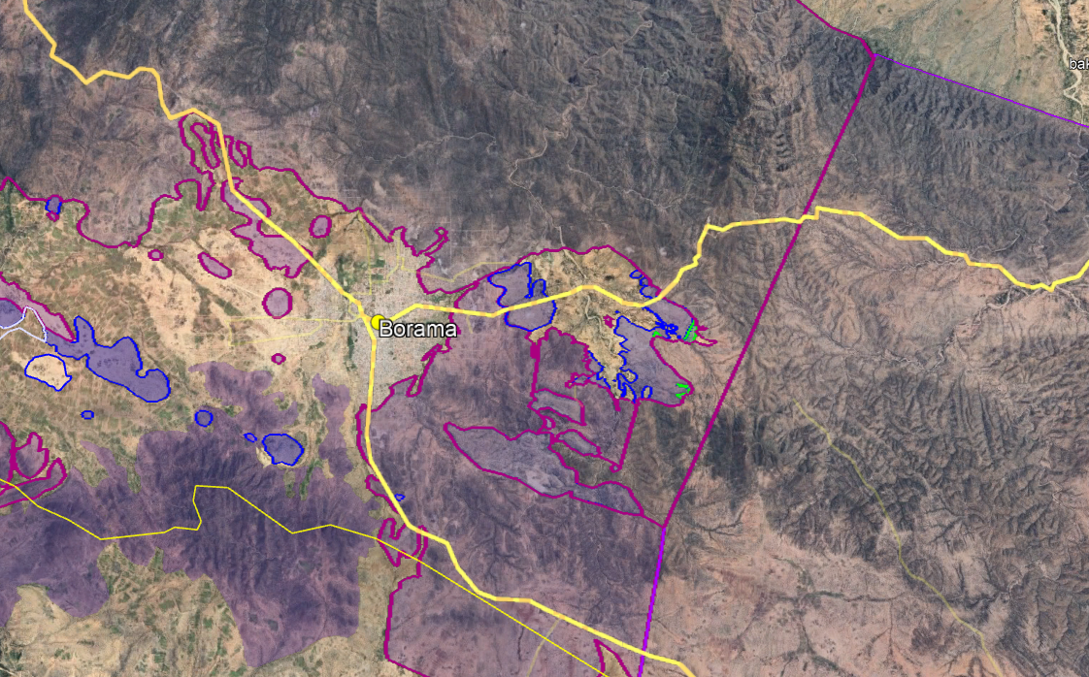

Borama Xamoud Geology
basement
basement
limestone
alluvial plain
limestone
limestone
Borama aquifer is located in the Jurassic Limestones, underlain by the impervious crystalline basement and overlain by an alluvial plain (dry)
limestone

Slide 3
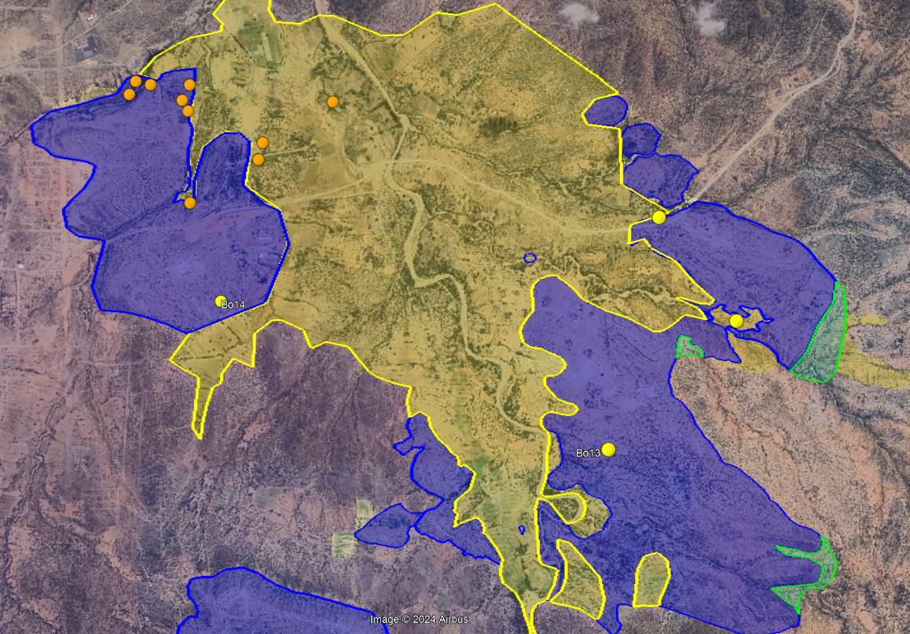
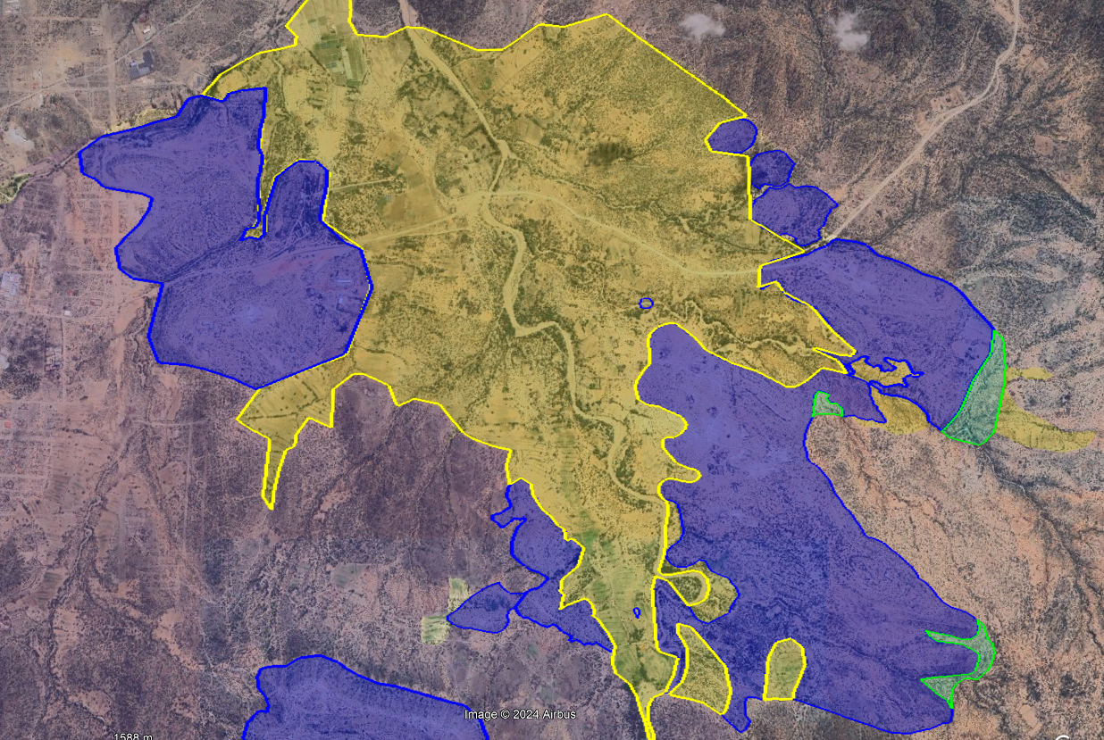
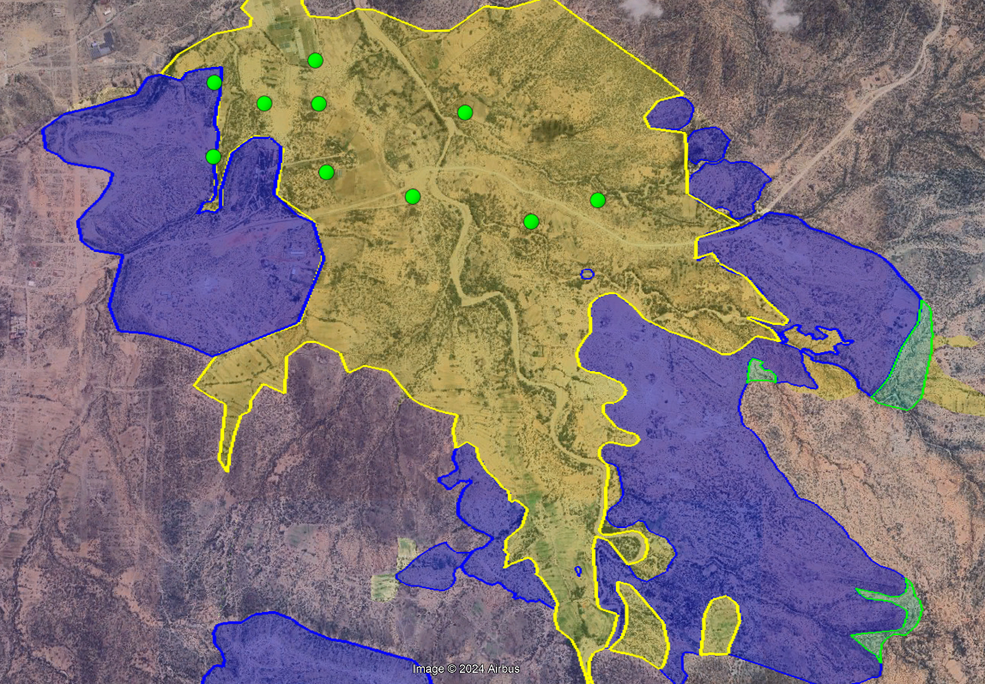
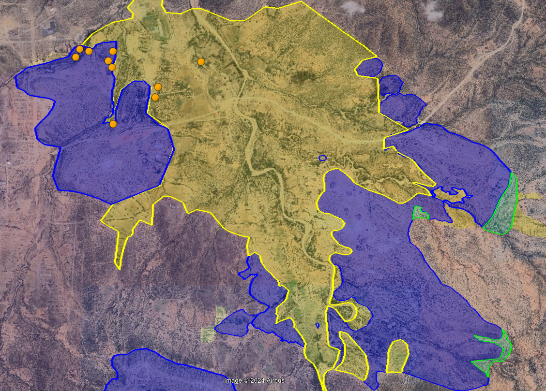
The Water
Before 2000 at Damouq hill foot foot there was a spring and shallow water was found in and near T. Xamoud
In the 80’s a chinese team drilled 10 boreholes: 6 were finalized to public supply, 3 rural, 1 for the university. The shallow water disappeared, and depletion accelerated in 2004.
Between 2008 and 2012, 5 new boreholes (one on Sheilaha hill) were drilled after a water study (UNICEF-Africa ‘70) to divert part of the production out of Damouq area to slow the aquifer depletion.
Between 2017 and 2022 10 new boreholes were drilled, the new production dried all previous drilled boreholes and a draw-down of 14 m/year of the SWL started.

Slide 4
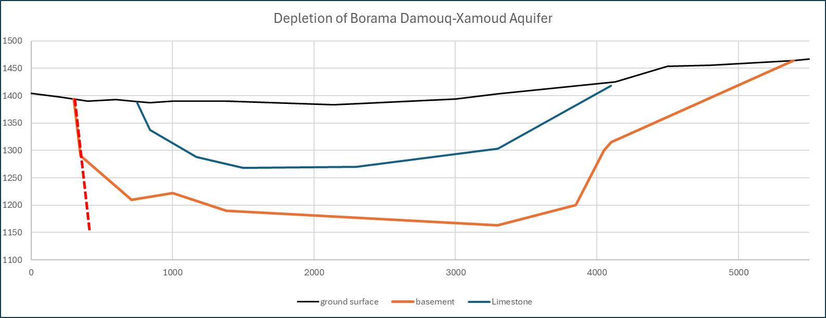
The Depletion
clayey alluvial deposits (impervious)
Jurassic Limestones and Adigrat Sandstones
basement
basement
Projection of the SWL in 2030
basement

Slide 5
How to slow the depletion
In 2014 the safe yield of the Damouq-Xamoud aquifer was estimated 2,000 m³/day
In 2023 the production reached 5,000 m³/day
In 2024 the production of east basin (Damouq-Xamoud) was reduced to 4,500 m³/day
In the next years it should be reduced to 3,500 m³/day in the hope to slow the water draw-down to 10 m/year and maintain the boreholes beyond 200 m of depth still in production.
Authorize the drilling of new boreholes shall bring to the total depletion of the aquifer.

